Slide 1
General Models of Combinatorial Optimization
Shaowei Cai

Slide 2
Combinatorial Optimization
Combinatorial optimization problems: optimization problems where the variables are discrete.
Combinatorial problems…
involve finding a solution (can be subset, ordering, or assignment etc.) for a set of discrete objects which satisfies certain constraints
arise in many domains of computer science and various application areas

Slide 3
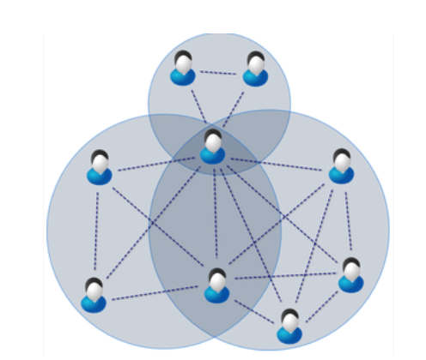
Maximum Clique
Given a graph G=(V,E)
A clique is a vertex subset C such that every vertex in C is adjacent to any other vertices in C.
Problem: Find a clique with the maximum size.
Applications: social network, protein structure analysis

Slide 4
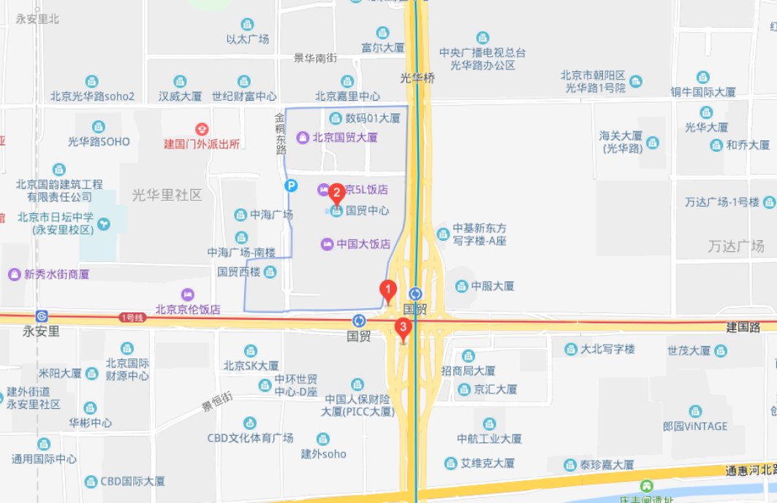
Maximum Independent Set
Given a graph G=(V,E)
An Independent set is a vertex subset C such that every vertex in C is not adjacent to any other vertices in C.
Problem: Find an independent set with the maximum size.
Applications: map labeling….

Slide 5

Minimum Vertex Cover
Given a graph G=(V,E)
A vertex cover is a vertex subset C such that every edge in G has at least one vertex in C.
Problem: Find a vertex cover with the minimum size.
Applications: Monitoring link failures in network (at which nodes of the network to put the monitor, so that we can know all the status of the every linkage)

Slide 6
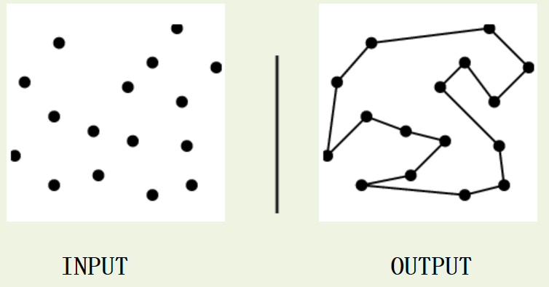
Traveling Salesman Problem
Input: A weighted graph G.
Problem: Find the cycle of minimum cost visiting all of the vertices of G exactly once.
Application: optimizing the paths for manufacturing equipment.

Slide 7
P Median Problem
Input: a set of candidate facilities, a set of clients
Problem: find p facilities to serve all clients, to optimize the cost (can be sum of serving distances)
Applications: logistics…

Slide 8


Bin Packing
Input: objects of different volumes, a finite number of bins each of volume V
Problem: objects must be packed into the bins in a way that minimizes the number of bins used.
Applications: filling up containers, loading trucks, creating file backs in media and technology mapping in FPGA and chip design.

Slide 9
Combinatorial Problems
More combinatorial problems:
vertex coloring
scheduling, time-tabling
resource allocation
Path planning
…

Slide 10
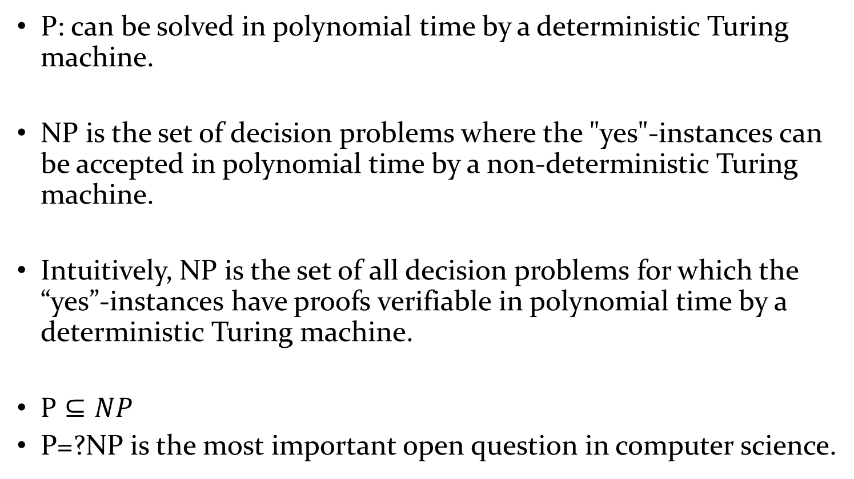
P vs. NP
P: can be solved in polynomial time by a deterministic Turing machine.
NP is the set of decision problems where the "yes"-instances can be accepted in polynomial time by a non-deterministic Turing machine.
Intuitively, NP is the set of all decision problems for which the “yes”-instances have proofs verifiable in polynomial time by a deterministic Turing machine.
$P⊆NP$
P=?NP is the most important open question in computer science.

Slide 11
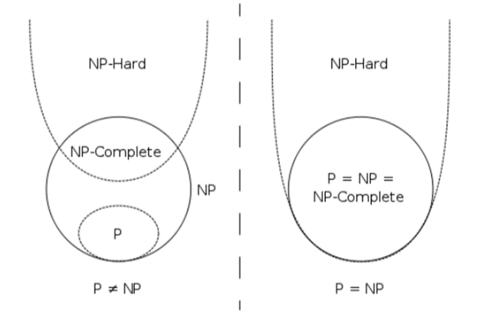
Combinatorial Problems are Hard
Many Combinatorial Optimization problems are usually NP-hard
NP-complete is a class of problems such that, any problem in NP can be reduced to such a problem in polynomial time.
NP-hardness is a class of problems that are, informally, "at least as hard as the hardest problems in NP (i.e. NP complete)".

Slide 12
Prove NP Completeness of a new problem
If we want to prove a problem X is NP complete, we need to reduce a NP-complete problem to X.
E.g. If we already know SAT is NPC, then to prove 3-SAT is NPC, we need to reduce SAT to 3-SAT.
For any SAT problem F, construct a 3-SAT problem F’=f(F), such that F is satisfiable ⬄F’ is satisfiable.

Slide 13
Tackling Combinatorial Optimization
Theoretical results: Computational complexity tells us that many combinatorial optimization problems are NP-hard.
Tackle hard combinatorial problems, theoretically..
Some subclasses of the problem can be easy
Approximation algorithms
Randomized (probabilistic) algorithms
Parameterized algorithms
…

Slide 14

The gap between theory and practice

Slide 15
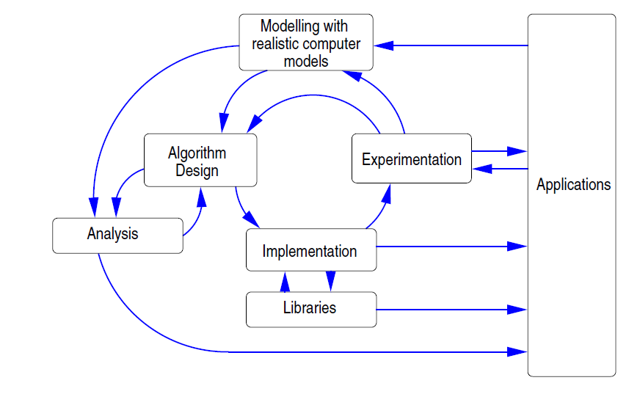
Algorithm Engineering
from 《 Algorithm engineering: Bridging the Gap between Algorithm Theory and Practice 》

Slide 16
Tackle hard combinatorial problems, practically!
General Models --- SAT and SMT
Heuristic Algorithms --- Local Search
Reasoning and Reduction Techniques

Slide 17
General Models

Slide 18

Hello, SAT!
The first NP-Complete problem [Cook, 1971]
Conceptually simple and easy to describe
Many theoretical results
Many important applications
Open source benchmarks and solvers
Annual competition

Slide 19
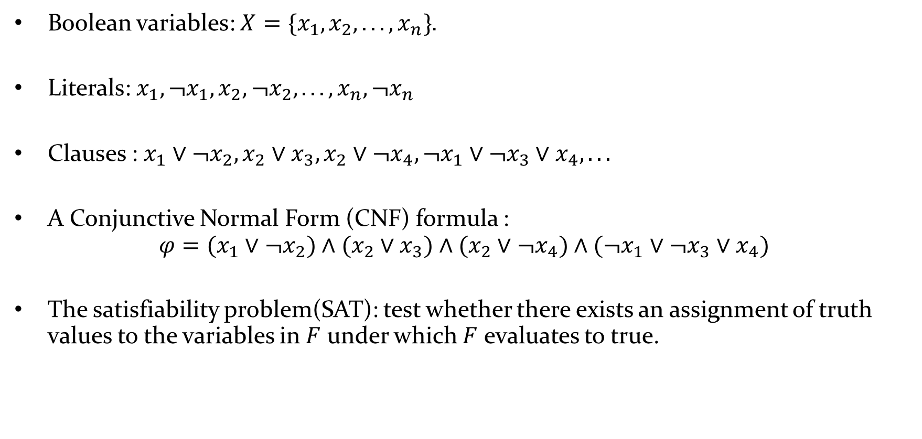
Boolean Satisfiability (SAT)
Boolean variables: $X=\{x_{1},x_{2},...,x_{n}\}$.
Literals: $x_{1},¬x_{1},x_{2},¬x_{2},...,x_{n},¬x_{n}$
Clauses : $x_{1}∨¬x_{2},x_{2}∨x_{3},x_{2}∨¬x_{4},¬x_{1}∨¬x_{3}∨x_{4},...$
A Conjunctive Normal Form (CNF) formula :
$$φ=(x_{1}∨¬x_{2})∧(x_{2}∨x_{3})∧(x_{2}∨¬x_{4})∧(¬x_{1}∨¬x_{3}∨x_{4})$$
The satisfiability problem(SAT): test whether there exists an assignment of truth values to the variables in $F$ under which $F$ evaluates to true.

Slide 20
Boolean Satisfiability (SAT)
Example: Determine the satisfiability of the following compound propositions:
Solution: Satisfiable. Assign T to p, q, and r.
Solution: Satisfiable. Assign T to p and F to q.
Solution: Not satisfiable. Check each possible assignment of truth values to the propositional variables and none will make the proposition true.

Slide 21
Applications of SAT
Hardware Model Checking
All major hardware companies (Intel, ...) use SAT solver to verify their chip designs
Software Verification
SAT solver based SMT solvers are used to verify Microsoft software products
Embedded software in Cars, Aiplanes, Refrigerators, ...
Unix utilities
Automated Planning and Scheduling
Still one of the best approaches for optimal planning
Number Theoretic Problems (Pythagorean Triples)
Solving other NP-hard problems (coloring, clique, ...)

Slide 22
Encoding Coloring to SAT
Graph coloring: given a graph G, an integer k, whether the vertices can be colored using k colors s.t. all neighboring vertices have different colors?
A traditional encoding:
for each vertex, uses k variables: x_{11,} x₁₂ … x_{1k,} x_{21,} x₂₂ … x_{2k,} … x_{n1,} x_{n2} … x_{nk}
x_{ic} means vertex i has color c.
For each edge, produces k negative 2-clause
For each vertex, produces a positive k-clauses
For each vertex, produces C(2,k) clauses to avoid being colored by more than one color. (Redundant in practical use)
4
1
3
2

Slide 23
4
3-coloring:
for each vertex, uses 3 variables (n vertices), 4*3 in all.
x_{11,} x_{12,} x_{13,} x_{21,} x_{22,} x_{23 ,} x_{31,} x_{32,} x_{33 ,} x_{41,} x_{42,} x₄₃
For each edge, produces 3 negative 2-clause
edge1-2: ¬ x₁₁ꓦ¬x₂₁, ¬ x₁₂ꓦ¬x₂₂, ¬ x₁₃ꓦ¬x₂₃;
edge1-4: ¬ x₁₁ꓦ¬x₄₁, ¬ x₁₂ꓦ¬x₄₂, ¬ x₁₃ꓦ¬x₄₃;
edge2-3: ¬ x₂₁ꓦ¬x₃₁, ¬ x₂₂ꓦ¬x₃₂, ¬ x₂₃ꓦ¬x₃₃;
edge2-4: ¬ x₂₁ꓦ¬x₄₁, ¬ x₂₂ꓦ¬x₄₂, ¬ x₂₃ꓦ¬x₄₃;
edge3-4: ¬ x₃₁ꓦ¬x₄₁, ¬ x₃₂ꓦ¬x₄₂, ¬ x₃₃ꓦ¬x₄₃;
For each vertex, produces a positive k-clauses
x₁₁ꓦx₁₂ꓦx_{13,} x₂₁ꓦx₂₂ꓦx_{23,} x₃₁ꓦx₃₂ꓦx_{33,} x₄₁ꓦx₄₂ꓦx₄₃
Result:
x_{11,} ¬ x_{12,} ¬ x_{13,} ¬ x_{21,} x_{22,} ¬ x_{23 ,} x_{31,} ¬ x_{32,} ¬ x_{33 ,} ¬ x_{41,} ¬ x_{42,} x₄₃
1
3
Color 1
2
Color 2
Color 3
4
1
3
2

Slide 24
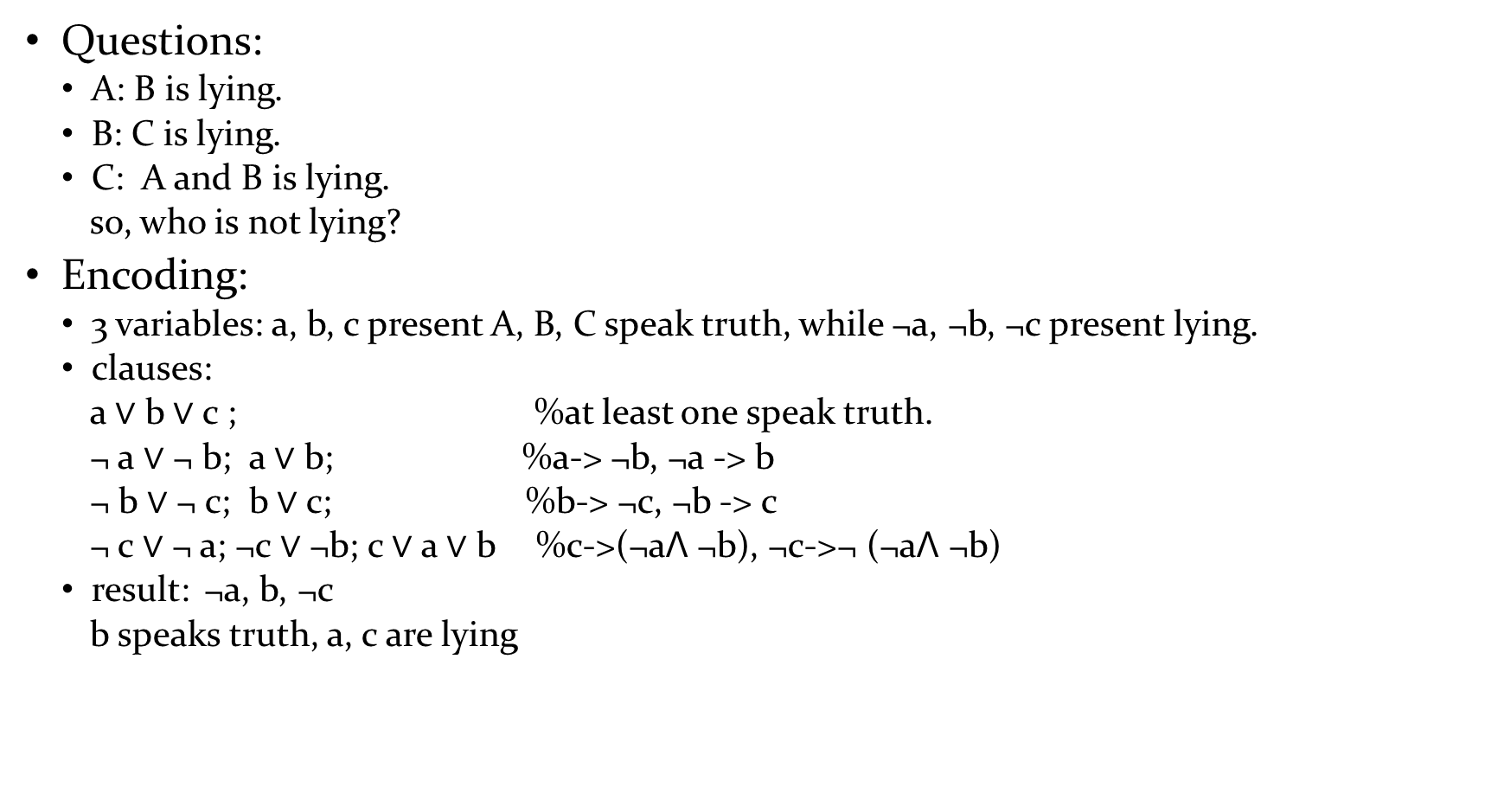
Who is Lying
Questions:
A: B is lying.
B: C is lying.
C: A and B is lying.
so, who is not lying?
Encoding:
3 variables: a, b, c present A, B, C speak truth, while ¬a, ¬b, ¬c present lying.
clauses:
a $∨$ b $∨$c ; %at least one speak truth.
¬ a $∨$ ¬ b; a $∨$ b; %a-> ¬b, ¬a -> b
¬ b $∨$ ¬ c; b $∨$ c; %b-> ¬c, ¬b -> c
¬ c $∨$¬ a; ¬c $∨$ ¬b; c $∨$ a $∨$ b %c->(¬aꓥ ¬b), ¬c->¬ (¬aꓥ ¬b)
result: ¬a, b, ¬c
b speaks truth, a, c are lying

Slide 25
Encoding Circuit to SAT
c
c
&
≥1
&
Assume a circuit consists only “AND” (c = a ^ b) logic.
“OR” logic can be presented by “AND” logic.
E.g. transfer circuit (3) to SAT
the input of this circuit is x1, x2
1) x3 ↔ x1 ꓥ x2
¬ x3 V x1; ¬x3 V x2; ¬ x1 V ¬ x2 V x3
2) x4 ↔ ¬ x1 ꓥ ¬ x2
¬ x4 V ¬ x1 ; ¬ x4 V ¬ x2; x1 V x2 V x4
3) x5 ↔ x3 ꓥ ¬ x4
¬ x5 V x3 ; ¬ x5 V ¬ x4; ¬ x3 V x4 V x5
To verify whether some property P holds for a circuit:
Test Satisfiability: F ꓥ ¬ P
a
b
a
b
(1)AND
(2)OR
a, b, c present variables.
x₅
&
x₃
x₄
&
&
x₁
x₂
x₁
x₂
(3)
x₁,…,x₅ present variables.

Slide 26
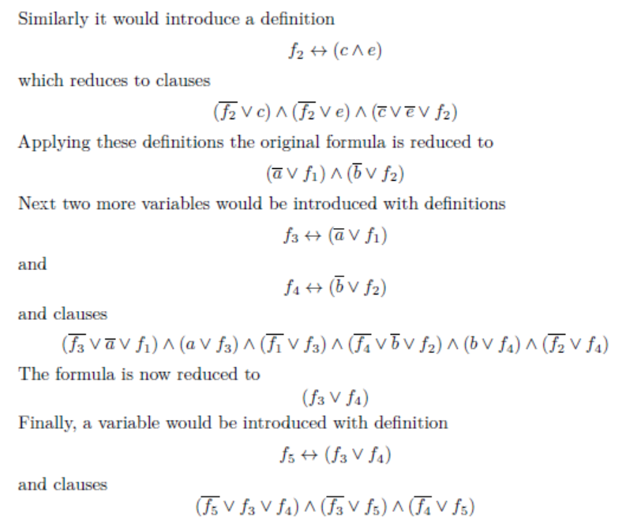



Tseitin encoding

Slide 27
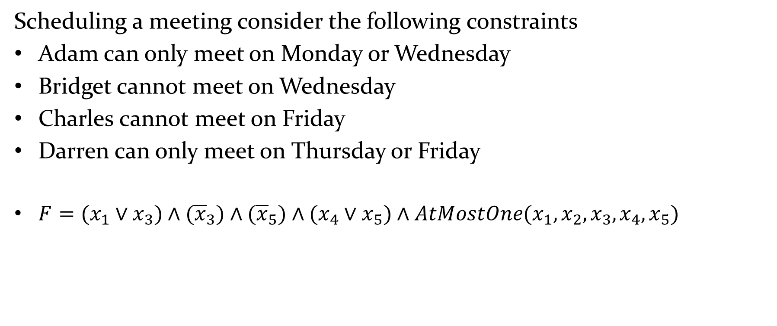
Encoding Meeting Scheduling to SAT
Scheduling a meeting consider the following constraints
Adam can only meet on Monday or Wednesday
Bridget cannot meet on Wednesday
Charles cannot meet on Friday
Darren can only meet on Thursday or Friday
$F=(x_{1}∨x_{3})∧({\overline{x}}_{3})∧({\overline{x}}_{5})∧(x_{4}∨x_{5})∧AtMostOne(x_{1},x_{2},x_{3},x_{4},x_{5})$

Slide 28



$$F=(x_{1}∨x_{3})∧({\overline{x}}_{3})∧({\overline{x}}_{5})∧(x_{4}∨x_{5})$$
$$∧({\overline{x}}_{1}∨{\overline{x}}_{2})∧({\overline{x}}_{1}∨{\overline{x}}_{3})∧({\overline{x}}_{1}∨{\overline{x}}_{4})∧({\overline{x}}_{1}∨{\overline{x}}_{5})$$
$$∧({\overline{x}}_{2}∨{\overline{x}}_{3})∧({\overline{x}}_{2}∨{\overline{x}}_{4})∧({\overline{x}}_{2}∨{\overline{x}}_{5})$$
$$∧({\overline{x}}_{3}∨{\overline{x}}_{4})∧({\overline{x}}_{3}∨{\overline{x}}_{5})$$
$$∧\left({\overline{x}}_{4}∨{\overline{x}}_{5}\right)$$
Solution: Unsatisfiable, i.e., it is impossible to schedule a meeting with these constraints

Slide 29
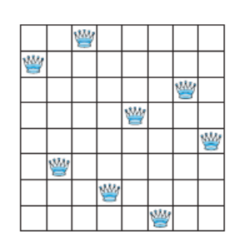
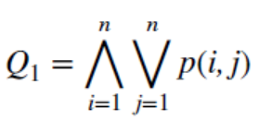
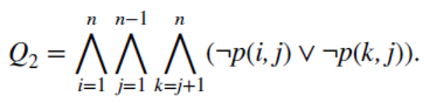
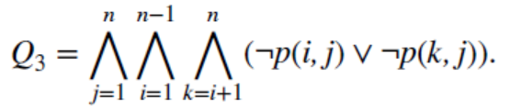
Encoding n-Queens Problem as SAT
p(i, j)： is true when there is a queen in the ith row and jth column
Assert that row i contains at least one queen
no column contains more than one queen
no column contains more than one queen

Slide 30
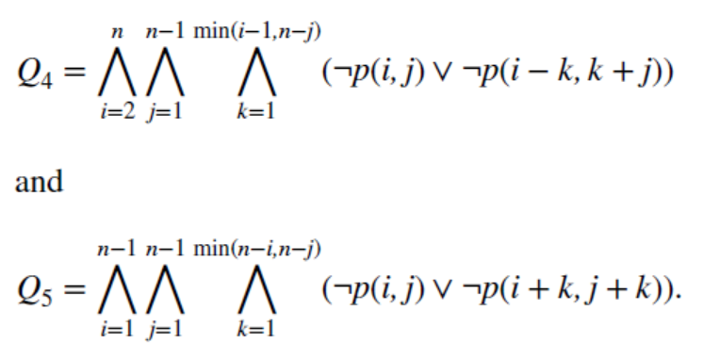
Encoding n-Queens Problem as SAT
p(i, j)： is true when there is a queen in the ith row and jth column
Assert that no diagonal contains two queens
The upper limits identify the last cell in the board on each diagonal.

Slide 31
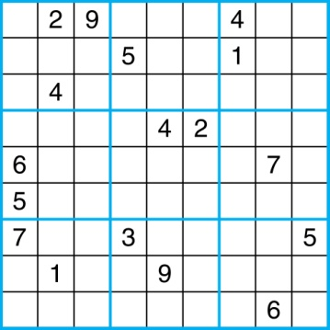
Encoding Sudoku to SAT
A Sudoku puzzle is represented by a 9×9 grid made up of nine 3×3 subgrids, known as blocks. Some of the 81 cells of the puzzle are assigned one of the numbers 1,2, …, 9.
The puzzle is solved by assigning numbers to each blank cell so that every row, column and block contains each of the nine possible numbers.
Example

Slide 32
Let p(i,j,n) denote the proposition that is true when the cell in the ith row and the jth column has number n.
Those variables that are assigned T yield a solution to the puzzle.
There are 9×9 × 9 = 729 such propositions.
In the sample puzzle p(5,1,6) is true, but p(5,j,6) is false for j = 2,3,…9

Slide 33
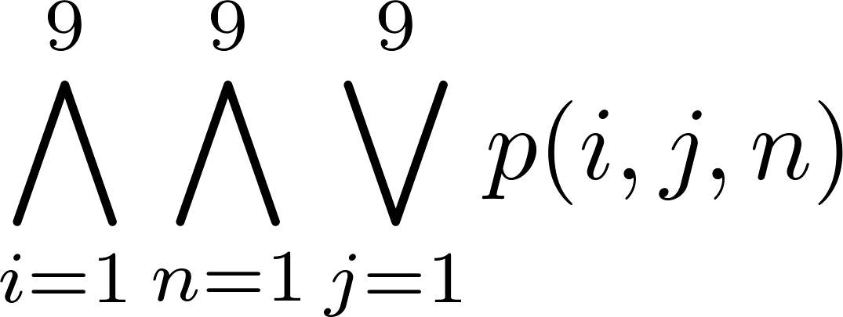
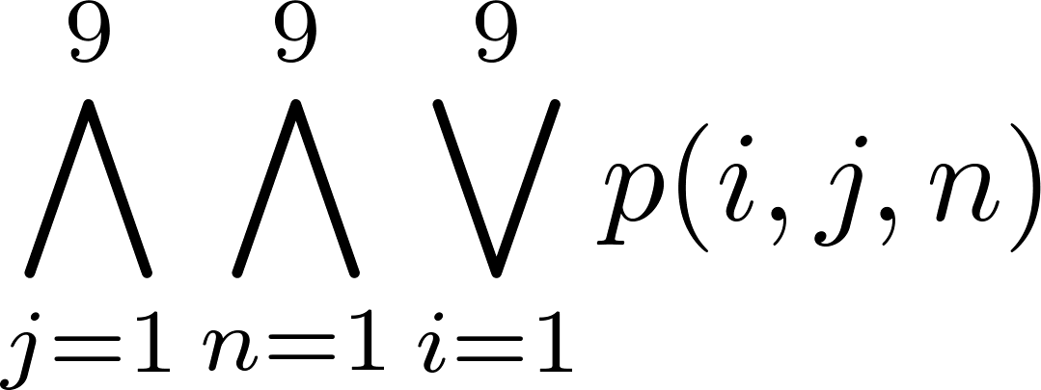
For each cell with a given value(已经有数字的cell), assert p(i,j,n), when the cell in row i and column j has the given value.
Assert that every row contains every number.
Assert that every column contains every number.

Slide 34

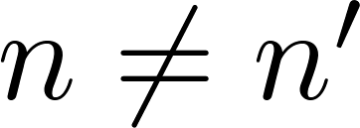
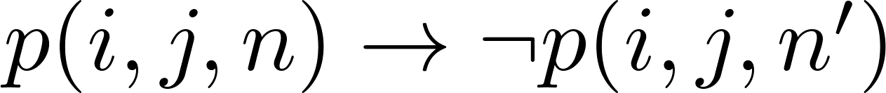
Assert that each of the 3 x 3 blocks contain every number.
Assert that no cell contains more than one number. Take the conjunction over all values of n, n’, i, and j, where each variable ranges from 1 to 9 and ,

Slide 35
Encoding Sokoban to SAT
Variables – For each location we have variable, the domain is WORKER, BOX, EMPTY
Initial State – assign values based on the picture
Goal – goal position variables have value BOX
Actions – move and push for each possible location
push(L1; L2; L3)
= ({L1 = W; L2 = B; L3 = E}; {L1 = E; L2 = W; L3 = B}).
move(L1; L2) = ({L1 = W; L2 = E}; {L1 = E; L2 = W})
We cannot encode the existence of a plan in general
But we can encode the existence of plan up to some length

Slide 36
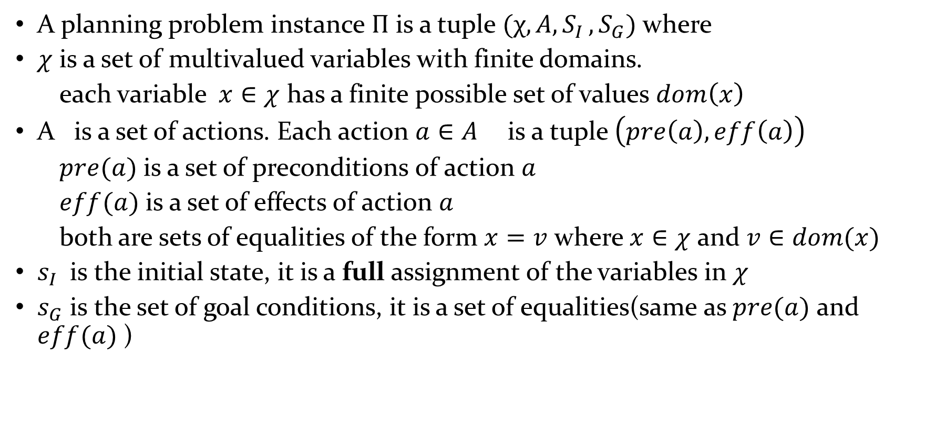
Planning Problem Definition
A planning problem instance $Π$ is a tuple $(χ, A{,S}_{I}, S_{G})$ where
$χ$ is a set of multivalued variables with finite domains.
each variable $x∈χ$ has a finite possible set of values $dom\left(x\right)$
A is a set of actions. Each action $a∈A$ is a tuple $\left(pre\left(a\right), eff\left(a\right)\right)$
$pre(a)$ is a set of preconditions of action $a$
$eff(a)$ is a set of effects of action $a$
both are sets of equalities of the form $x=v$ where $x∈χ$ and $v∈dom(x)$
$s_{I}$ is the initial state, it is a full assignment of the variables in $χ$
$s_{G}$ is the set of goal conditions, it is a set of equalities(same as $pre(a)$ and $eff(a)$ )

Slide 37
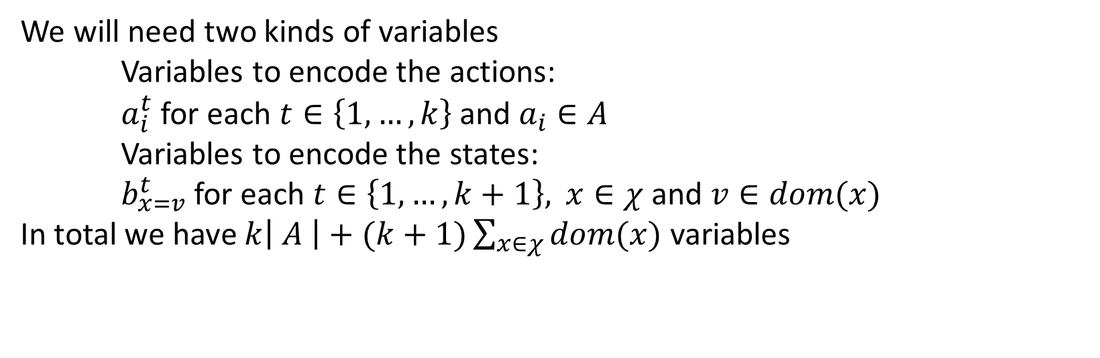

The task
Given a planning problem instance $Π=\left(χ, A, s_{I}, S_{G}\right)$ and $k∈N$ construct a CNF formula $F$ sus that $F$ satisfiable if and only if there is plan of length$k$ for $Π$
We will need two kinds of variables
Variables to encode the actions:
$a_{i}^{t}$ for each $t∈\left\{1,…,k\right\}$ and $a_{i}∈A$
Variables to encode the states:
$b_{x=v}^{t}$ for each $t∈\left\{1,…,k+1\right\},$ $x∈χ$ and $v∈dom(x)$
In total we have $k\left| A \right|+(k+1)\sum_{x∈χ}{dom(x)}$ variables

Slide 38
We will need 8 kinds of clauses
The first state is the initial state
The goal conditions are satisfied in the end
Each state variable has at least one value
Each state variable has at most one value
If an action is applied it must be applicable
If an action is applied its effects are applied in the next step
State variables cannot change without an action between steps
At most one action is used in each step

Slide 39
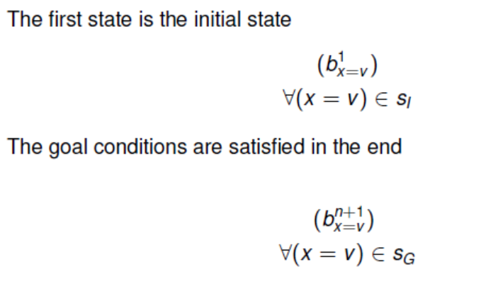

Slide 40
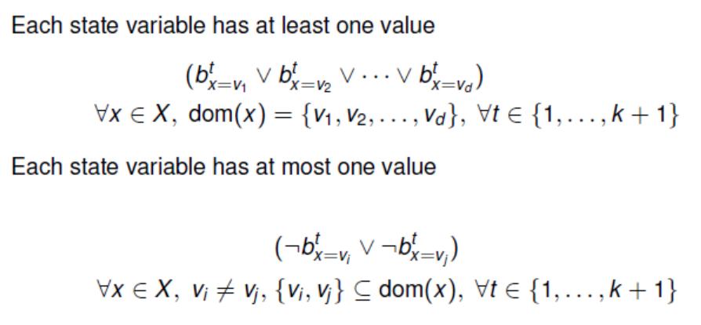

Slide 41
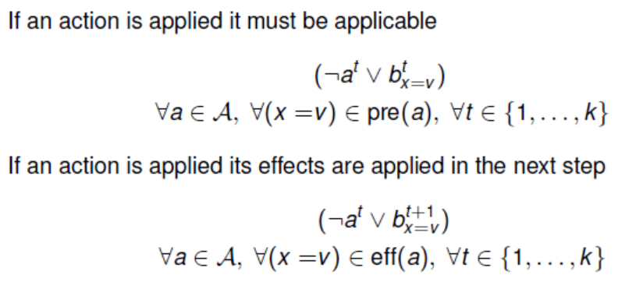

Slide 42
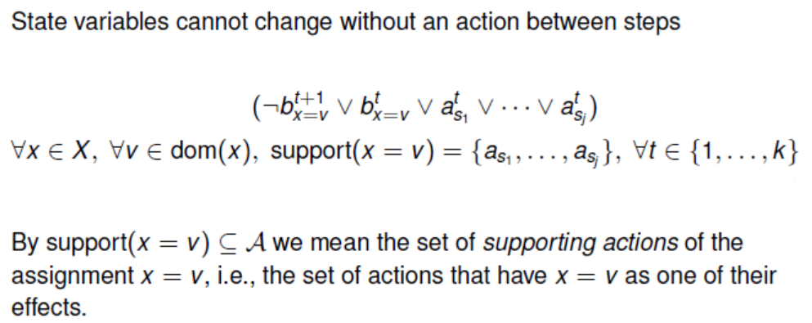
对于某个位置x，如果第t步它不在状态x=v, 并且第t步没有执行任何可以得到x=v的动作，那么在t+1步，x仍然不会在状态x=v。

Slide 43
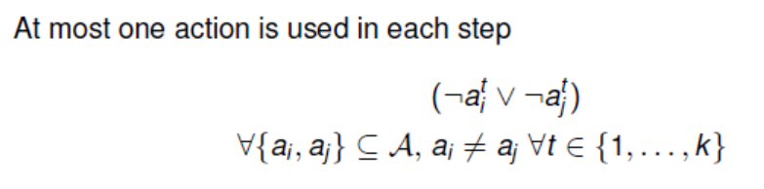

Slide 44
Find SAT Solvers
Today, SAT solvers can handle formulas with millions of variables.
SAT competitions
Keep your eyes on recent improvements
Find them on the homepages
Or, you can send emails

Slide 45
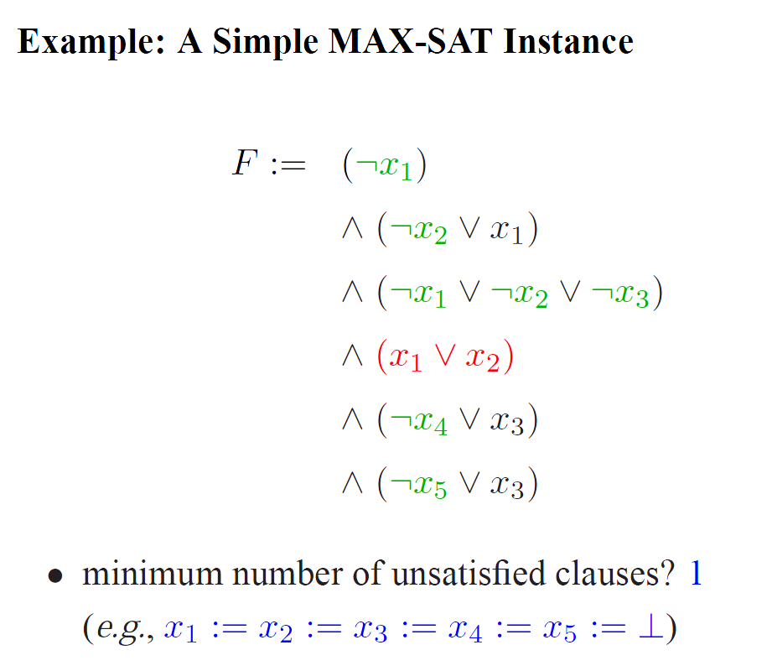
MaxSAT
When the formula is not satisfiable, we concern about satisfying as many clauses as possible -> Maximum Satisfiability.

Slide 46
Variants of MaxSAT
Weighted MaxSAT
Each clause is associated with a weight, the goal: maximize the total weight of satisfied clauses
Partial MaxSAT
hard clauses: must be satisfied
soft clauses: to satisfy as many as possible
the goal: satisfy all hard clauses and as many soft clauses as possible.
Weighted Partial MaxSAT
Each soft clause is associated with a weight
The goal: satisfy all hard clauses and maximize the total weight of satisfied soft clauses.

Slide 47
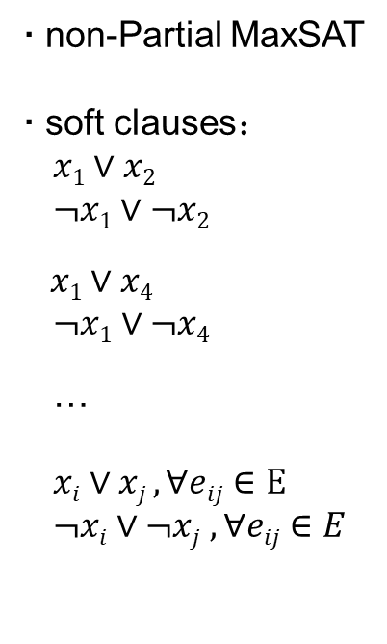
Encoding MaxCut to MaxSAT
MaxCut: to maximize the numbers of edges in a graph that are “cut” by partitioning the vertices into two sets.
x₁
x₂
x₄
x₃
Graph : G = (E, V)

Slide 48
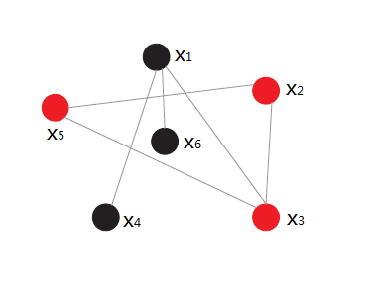
Encoding MaxClique to Partial MaxSAT
MaxClique Problem
Partial MaxSAT
hard clauses:
soft clauses:
Graph: G=(E, V)

Slide 49
Encoding MaxClique to Partial MaxSAT
Encoding MaxClique to Partial MaxSAT
for each vertex, uses one variable. x_{i} = 1 means vertex x is selected.
For each pair of vertices not adjacent, produces a negative 2-clause as hard clause, saying they cannot be both chosen.
For each vertex, produces a positive unit clause as soft clause.

Slide 50
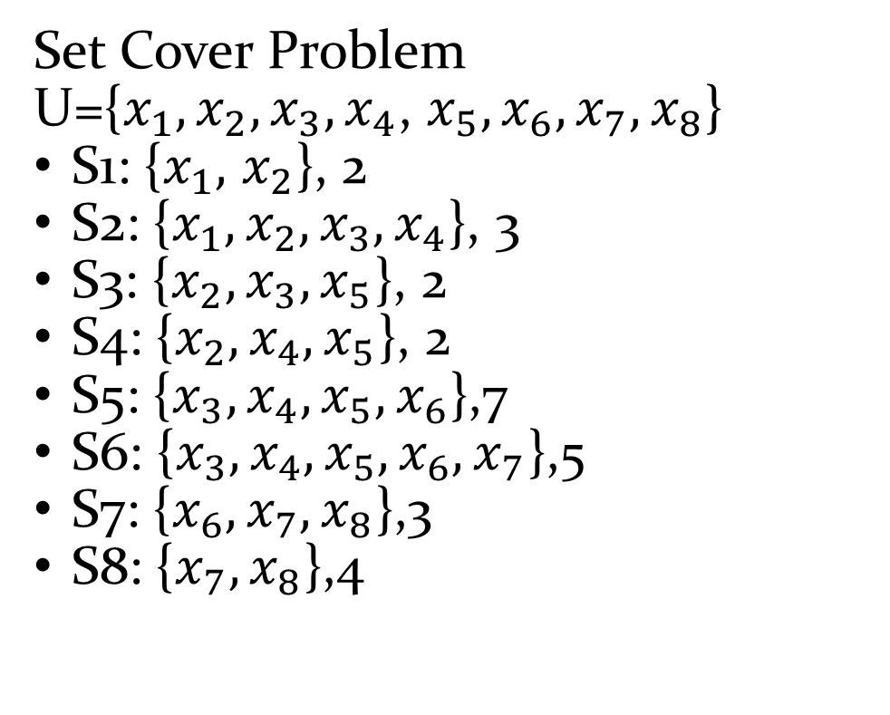
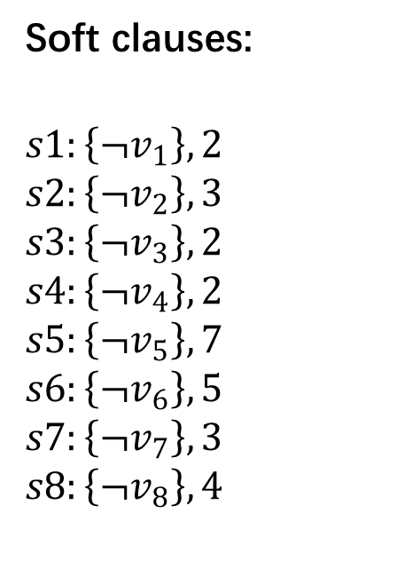
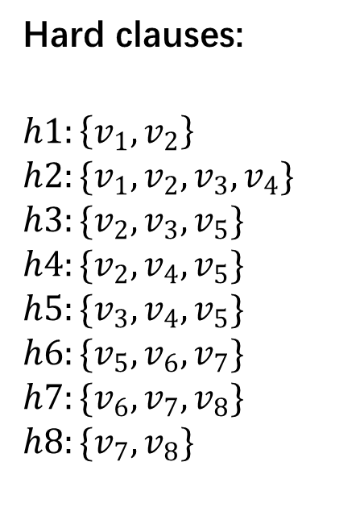
Encoding Set Cover Problem to Weighted Partial MaxSAT
Set Cover Problem
U={$x_{1},x_{2},x_{3},x_{4}$, $x_{5},x_{6},x_{7},x_{8}$}
S1: {$x_{1},$ $x_{2}$}, 2
S2: {$x_{1},x_{2},x_{3},x_{4}$}, 3
S3: {$x_{2},x_{3},x_{5}$}, 2
S4: {$x_{2},x_{4},x_{5}$}, 2
S5: {$x_{3},x_{4},x_{5},x_{6}$},7
S6: {$x_{3},x_{4},x_{5},x_{6},x_{7}$},5
S7: {$x_{6},x_{7},x_{8}$},3
S8: {$x_{7},x_{8}$},4
Hard clauses:
$$h1:\left\{v_{1},v_{2}\right\}$$
$$h2:\{v_{1},v_{2},v_{3},v_{4}\}$$
$$h3:\{v_{2},v_{3},v_{5}\}$$
$$h4:\{v_{2},v_{4},v_{5}\}$$
$$h5:\{v_{3},v_{4},v_{5}\}$$
$$h6:\{v_{5},v_{6},v_{7}\}$$
$$h7:\{v_{6},v_{7},v_{8}\}$$
$$h8:\{v_{7},v_{8}\}$$
Soft clauses:
$$s1:\left\{¬v_{1}\right\}, 2$$
$$s2:\left\{{¬v}_{2}\right\}, 3$$
$$s3:\left\{{¬v}_{3}\right\}, 2$$
$$s4:\left\{{¬v}_{4}\right\}, 2$$
$$s5:\left\{{¬v}_{5}\right\}, 7$$
$$s6:\left\{{¬v}_{6}\right\}, 5$$
$$s7:\left\{{¬v}_{7}\right\}, 3$$
$$s8:\left\{{¬v}_{8}\right\}, 4$$

Slide 51
Constraint Satisfiability Problem (CSP)
Constraint Satisfiability Problem
P=<X,D,C>
X: variables
D: domains
C: constraints
Express constraints
Extensional
Intensional
Encoding the n-queue problem to CSP
Q
Q
Q
Q
Variables: x₁, x₂, x₃, x₄

Slide 52
Constraint Satisfiability Problem (CSP)
Constraint Satisfiability Problem
P=<X,D,C>
X: variables
D: domains
C: constraints
Express constraints
Extensional
Intensional
Encoding the n-queue problem to CSP
Q
Q
Q
Q
Variables: x₁, x₂, x₃, x₄
D₁, D₂, D₃, D₄ (D_{i} = {1,2,3,4})
x_{i} ≠ x_{j} (0<i<j≤n) ;
|x_{i}-x_{j}| ≠ |i-j|. (0<i<j≤n)
Notes:
这里不需要考虑同一列不能出现两个皇后的冲突，因为我们的变量是定义在一列上的，比如x2取1，就表示第二列只有第一格有皇后。因为这个变量不能同时取两个值，也就表示了列冲突了。

Slide 53
Satisfiability Modulo Theories (SMT)
Satisfiability Modulo Theories
Propositional logic is usually not sufficient in many problems.
First Order Logic: powerful to express most real world applications.
But, first order logic is generally undecidable!
SMT: takes segments of first order logic
Only considers certain background theories.

Slide 54
What is a SMT instance?
A logical formula built using
negation, conjunction and disjuction
e.g. $a∧\left(b∨c\right)$
e.g. $\left(a∨¬b∨c\right)∧\left(¬b∨¬x∨y\right)∧\left(b∨b∨x\right)$
theory specific operators
e.g. $x≤5$, $y≠z$
e.g. $\left(m⊕n\right)⊕n=m$
e.g. $f\left(x\right)=f(y)∧f(f\left(x\right))≠f(f\left(y\right))$

Slide 55
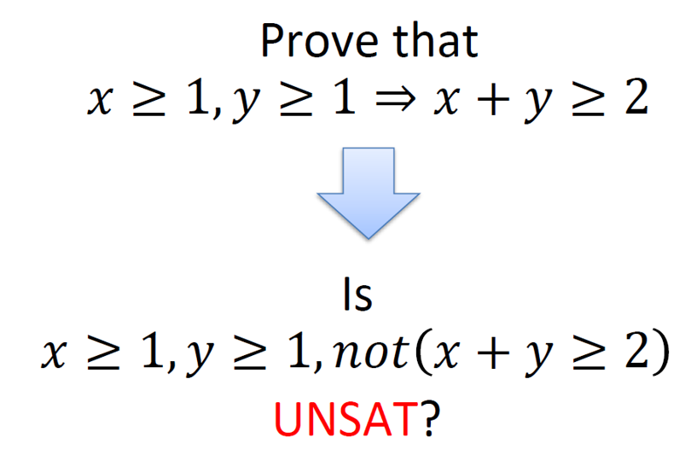
Checking validity by SMT

Slide 56
Satisfiability Modulo Theories (SMT)
Theory of:
Difference Arithemetic
Linear Arithmetic
Arrays
Bit Vectors
Algebraic Datatypes
Uninterpreted Functions
A modeling language for SMT instances
A declarative language with Lisp-like syntax
http://www.smtlib.org/
Powerful SMT solvers
Z3 (http://research.microsoft.com/projects/z3)
Yices (http://yices.csl.sri.com)
CVC

Slide 57
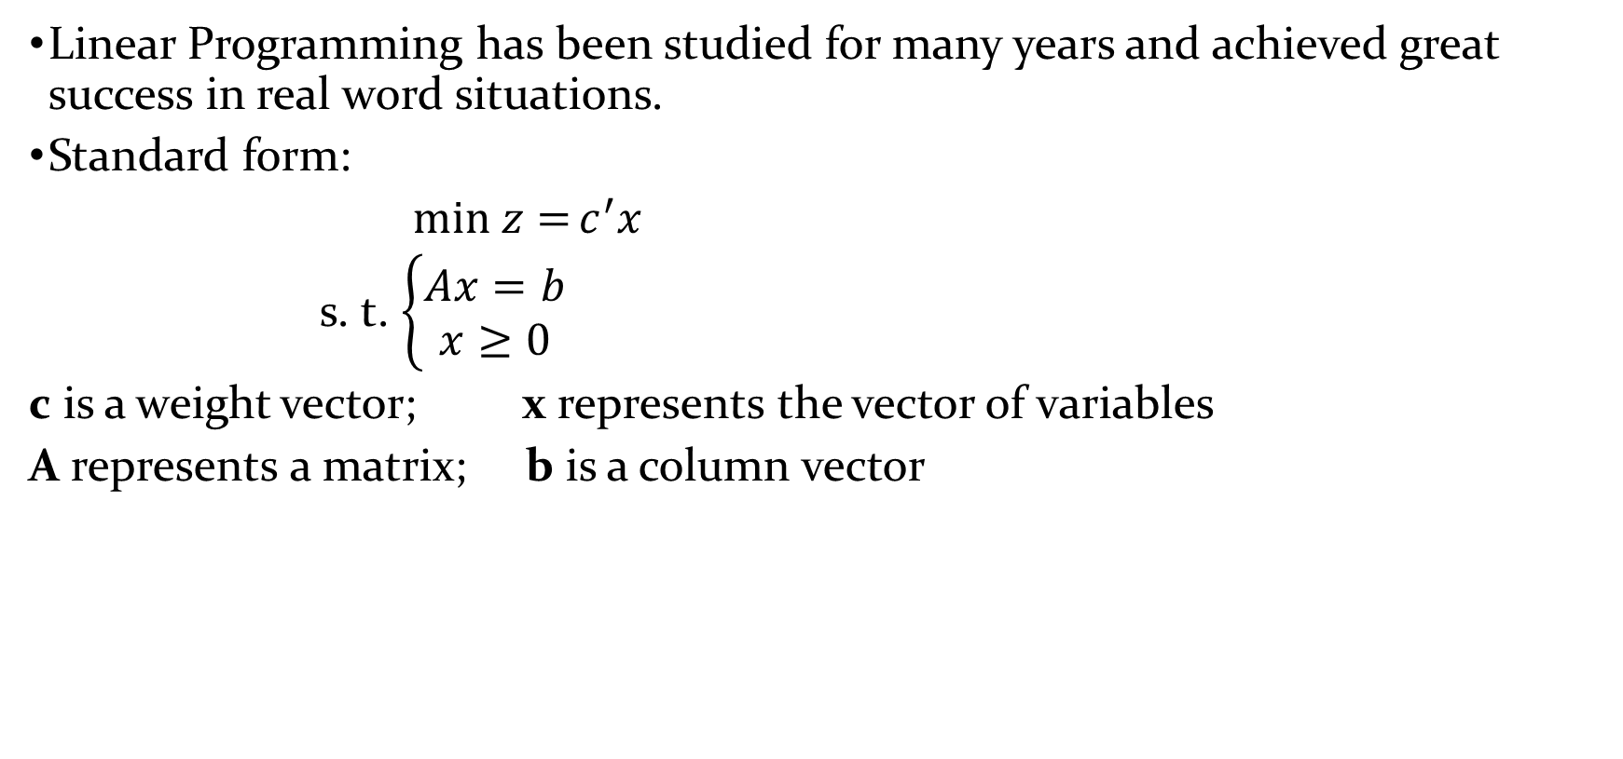
Linear Programming (LP)
Linear Programming has been studied for many years and achieved great success in real word situations.
Standard form:
$min z={c^{′}x}$
s. t. $\left\{\begin{aligned}Ax=b \\ x≥0\end{aligned}\right.$
c is a weight vector; x represents the vector of variables
A represents a matrix; b is a column vector

Slide 58
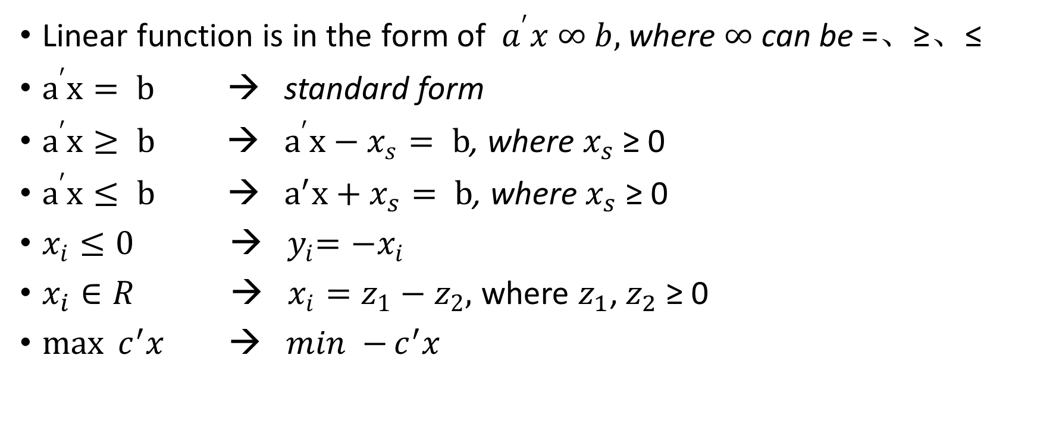
LP
Linear function is in the form of $a^{′}x ∞ b,$where $∞$ can be =、≥、≤
$a^{′}x= b$ → standard form
$a^{′}x≥ b$ → $a^{′}x−x_{s}= b$, where $x_{s}$ ≥ 0
$a^{′}x≤ b$ → ${ a}^{′}x+x_{s}= b$, where $x_{s}$ ≥ 0
$x_{i}≤0$ → ${ y}_{i}=−x_{i}$
$x_{i}∈R$ → $x_{i}=z_{1}−z_{2},$ where $z_{1}$, $z_{2}$ ≥ 0
$\max{c^{′}x}$ → $min −{c^{′}x}$

Slide 59
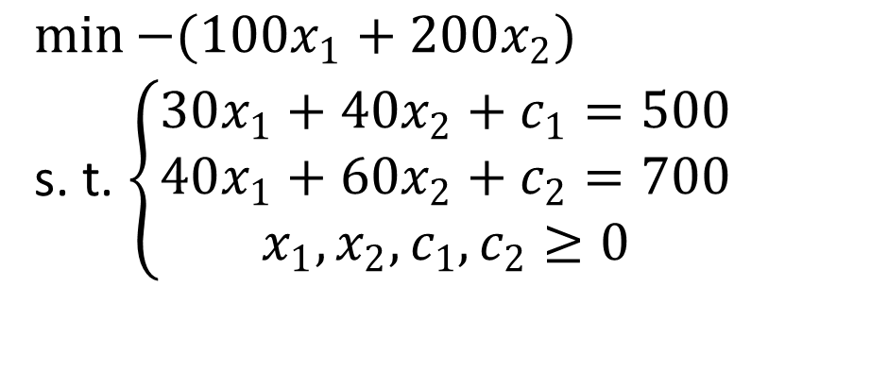

LP
Example:
$\max{100x_{1}+200x_{2}}$
s. t. $\left\{\begin{aligned}30x_{1}+40x_{2}≤500 \\ 40x_{1}+60x_{2}≤700 \\ x_{1},x_{2}≥0\end{aligned}\right.$ →
$$\min{−(100x_{1}+200x_{2})}$$
s. t. $\left\{\begin{aligned}30x_{1}+40x_{2}+c_{1}=500 \\ 40x_{1}+60x_{2}+c_{2}=700 \\ x_{1},x_{2},c_{1},c_{2}≥0\end{aligned}\right.$
Turn to standard form
Apply the general LP solver
→The main methods are simplex method, dual simplex method

Slide 60
ILP and MILP
If all the variables in LP are restricted to integers, the resulting problem is Integer Linear Programming (ILP)
If olny a part of the variables in LP is restricted to integers, the resulting problem is Mix Integer Linear Programming (MILP)
Encoding problems into ILP or MILP
Apply specific solvers like Gurobi

Slide 61
Example:
Three kinds of food: corn, milk and bread.
s.t. : 1. the total intake of vitamin A is not less than 500
2. the total intake of Vitamin B is not less than 1000
Goal: minimize the total cost
Food | Cost per serving | Vitamin A | Vitamin B
Corn | $0.18 | 107 | 72
Milk | $0.23 | 500 | 121
Wheat Bread | $0.05 | 0 | 65

Slide 62
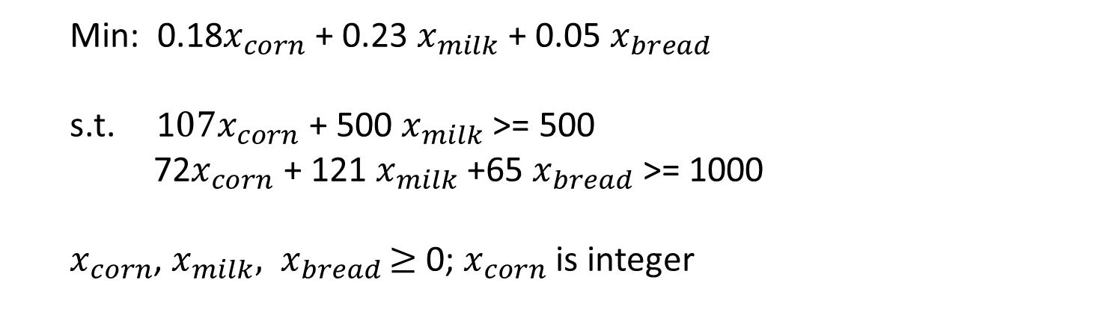
Example:
Food | Cost per serving | Vitamin A | Vitamin B
Corn | $0.18 | 107 | 72
Milk | $0.23 | 500 | 121
Wheat Bread | $0.05 | 0 | 65
s.t. : 1. the total intake of vitamin A is not less than 500 Goal: minimize the total cost
2. the total intake of Vitamin B is not less than 1000
Min: 0.18$x_{corn}$ + 0.23 $x_{milk}$ + 0.05 $x_{bread}$
s.t. 1$07x_{corn}$ + 500 $x_{milk}$ >= 500
72$x_{corn}$ + 121 $x_{milk}$ +65 $x_{bread}$>= 1000
$x_{corn}$, $x_{milk}{, x}_{bread}≥$0; $x_{corn}$ is integer

Slide 63
Encoding Nurse Rostering to ILP
Nurse Rostering :
The basic problem consists in the weekly scheduling of a fixed number of nurses using a set of shifts, such that in each day a nurse works a shift or has a day-off.
Nurses may have multiple skills, and for each skill we are given different coverage requirements.

Slide 64
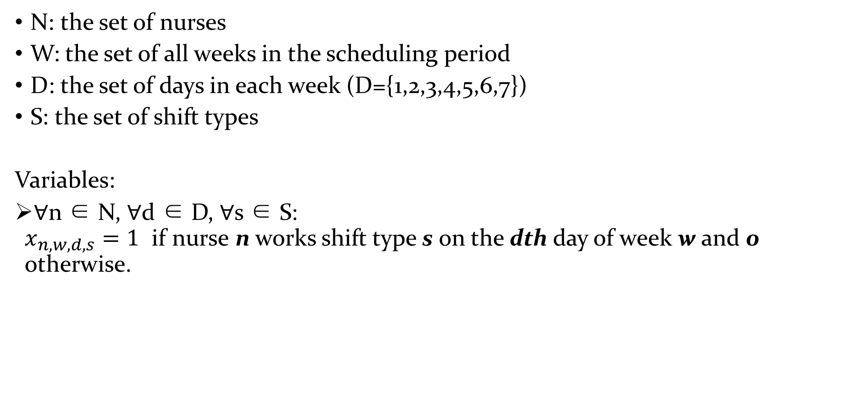
Data and variables
N: the set of nurses
W: the set of all weeks in the scheduling period
D: the set of days in each week (D={1,2,3,4,5,6,7})
S: the set of shift types
Variables:
∀n ∈ N, ∀d ∈ D, ∀s ∈ S: $x_{n,w,d,s}=1$ if nurse n works shift type s on the dth day of week w and 0 otherwise.

Slide 65
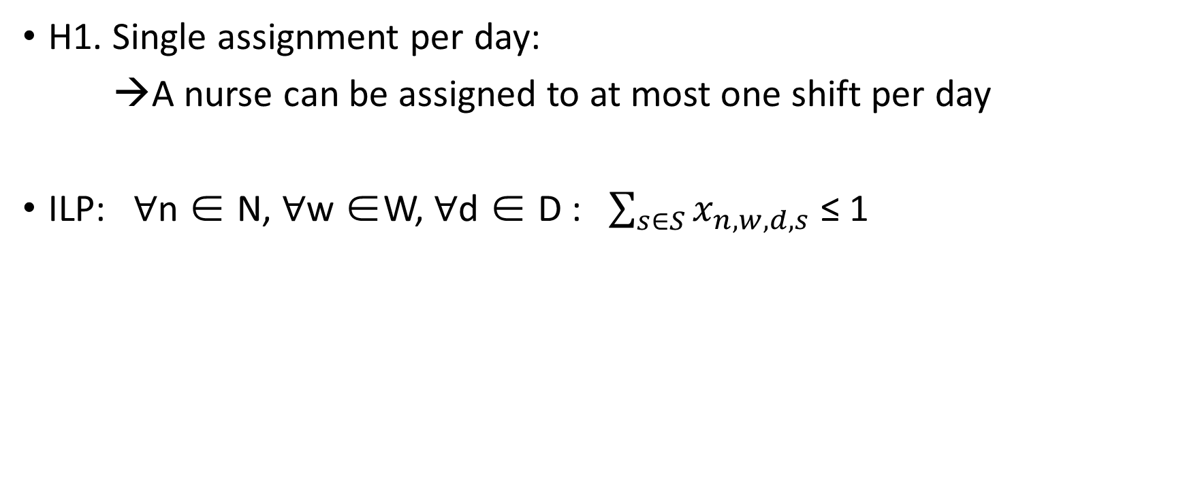
Hard (H) constraint types:
H1. Single assignment per day:
→A nurse can be assigned to at most one shift per day
ILP: ∀n ∈ N, ∀w ∈W, ∀d ∈ D : $\sum_{s∈S}{x_{n,w,d,s}}$ ≤ 1

Slide 66
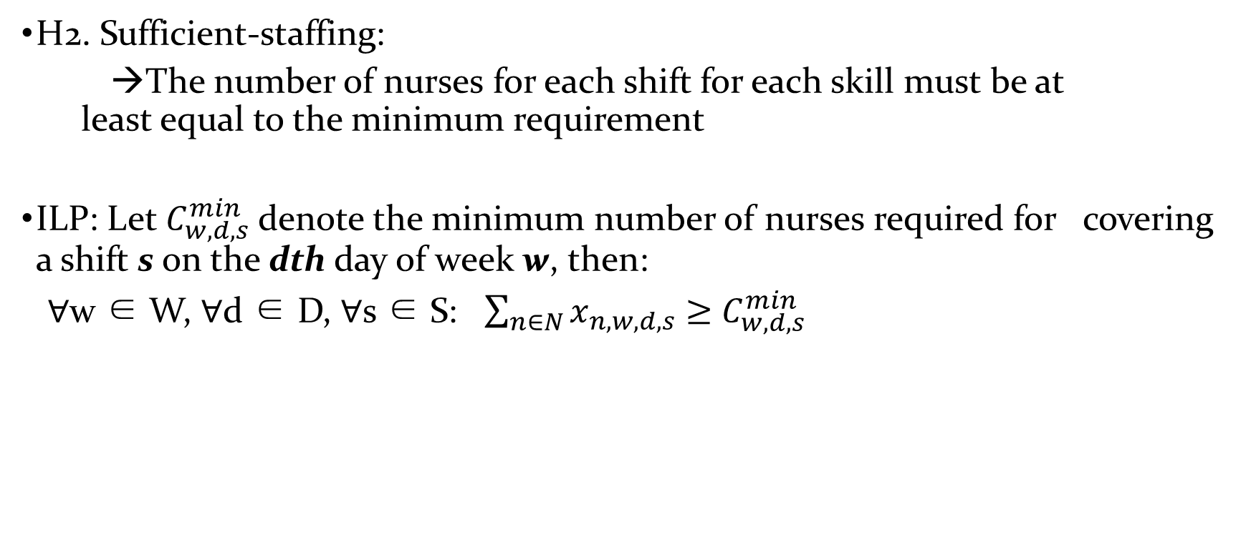
Hard (H) constraint types:
H2. Sufficient-staffing:
→The number of nurses for each shift for each skill must be at least equal to the minimum requirement
ILP: Let $C_{w,d,s}^{min}$denote the minimum number of nurses required for covering a shift s on the dth day of week w, then:
∀w ∈ W, ∀d ∈ D, ∀s ∈ S: $\sum_{n∈N}{x_{n,w,d,s}}$ $≥$ $C_{w,d,s}^{min}$

Slide 67
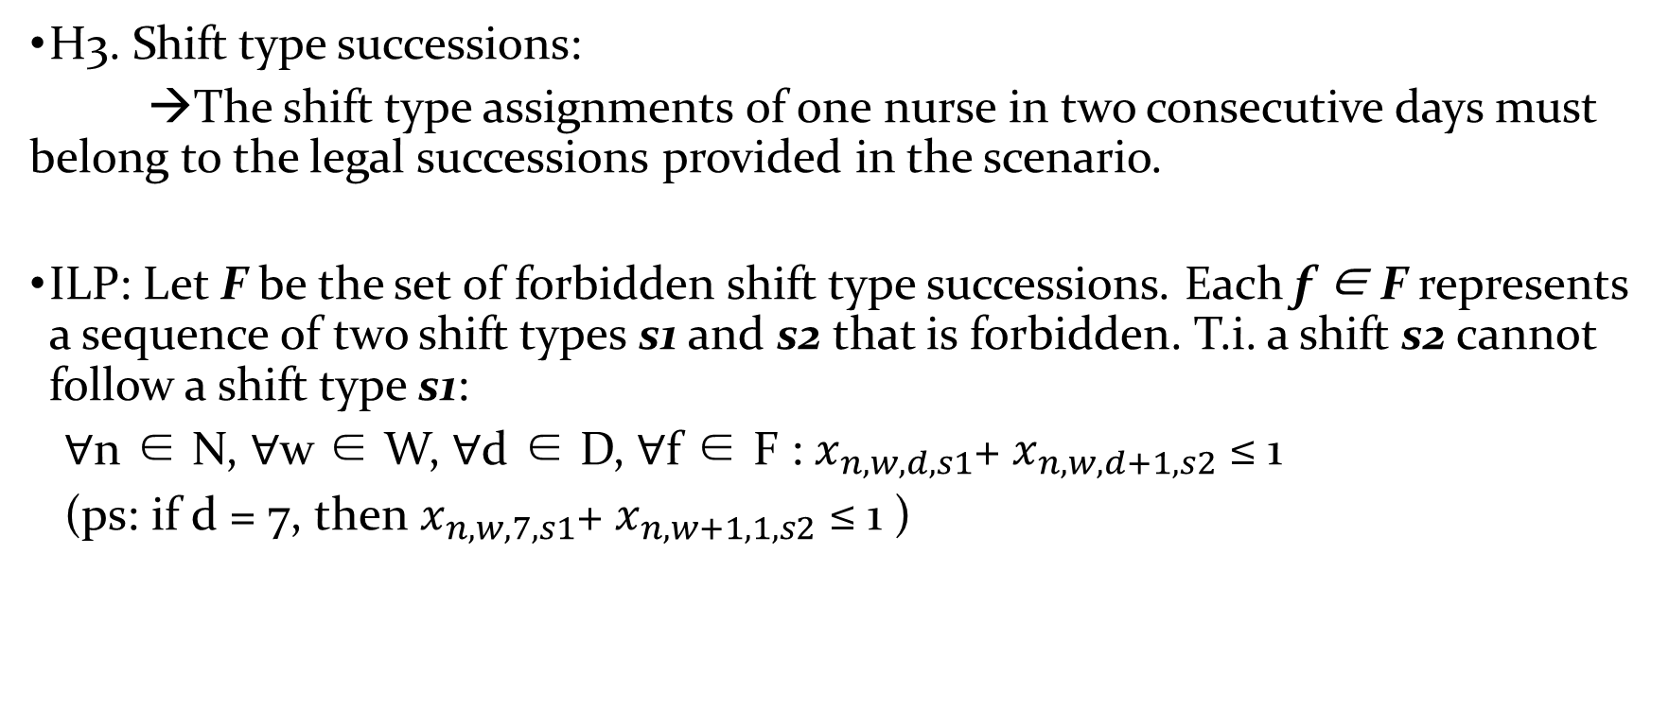
Hard (H) constraint types:
H3. Shift type successions:
→The shift type assignments of one nurse in two consecutive days must belong to the legal successions provided in the scenario.
ILP: Let F be the set of forbidden shift type successions. Each f ∈ F represents a sequence of two shift types s1 and s2 that is forbidden. T.i. a shift s2 cannot follow a shift type s1:
∀n ∈ N, ∀w ∈ W, ∀d ∈ D, ∀f ∈ F : $x_{n,w,d,s1}$+ $x_{n,w,d+1,s2}$ ≤ 1
(ps: if d = 7, then $x_{n,w, 7,s1}$+ $x_{n,w+1, 1,s2}$ ≤ 1 )

Slide 68
Soft (S) constraints types:
Allowed falsified
Incur a penalty to the cost

Slide 69
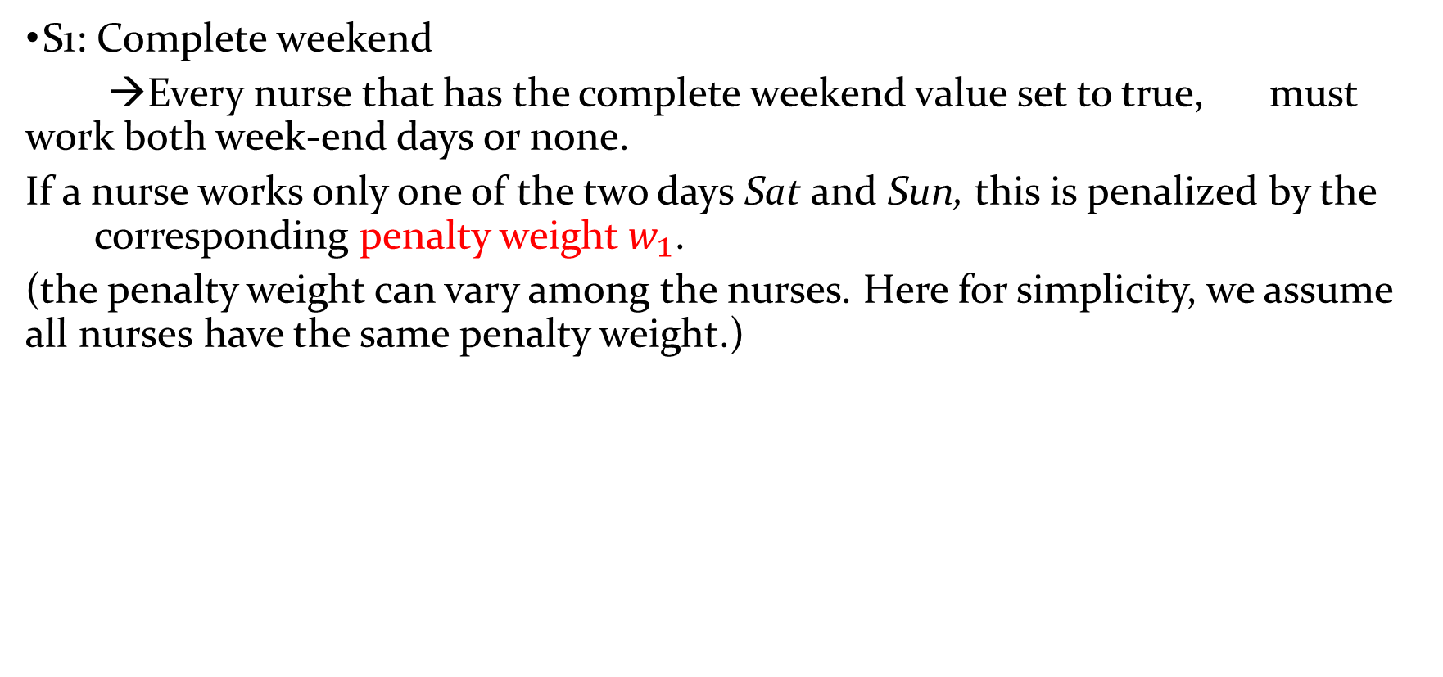
Soft (S) constraints types:
S1: Complete weekend
→Every nurse that has the complete weekend value set to true, must work both week-end days or none.
If a nurse works only one of the two days Sat and Sun, this is penalized by the corresponding penalty weight $w_{1}$.
(the penalty weight can vary among the nurses. Here for simplicity, we assume all nurses have the same penalty weight.)

Slide 70
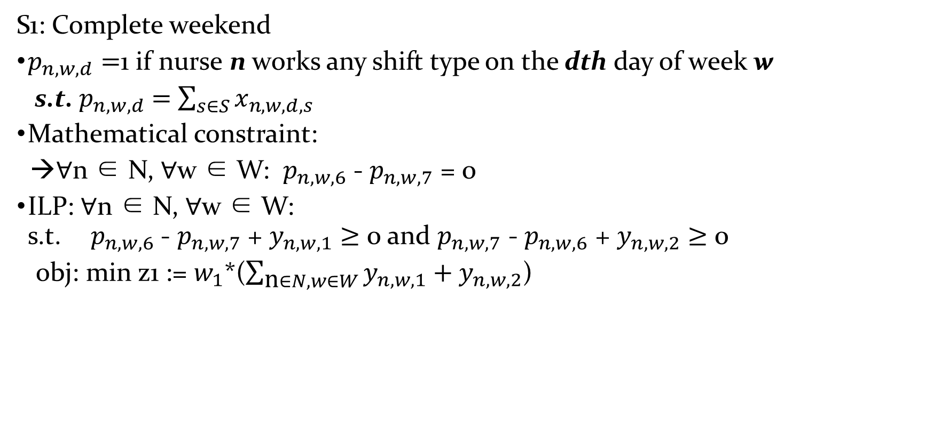
Soft (S) constraints types:
S1: Complete weekend
$p_{n,w,d}=$1 if nurse n works any shift type on the dth day of week w
s.t. $p_{n,w,d}$ $=$ $\sum_{s∈S}{x_{n,w,d,s}}$
Mathematical constraint:
→∀n ∈ N, ∀w ∈ W: $p_{n,w,6}$ - $p_{n,w,7}$ = 0
ILP: ∀n ∈ N, ∀w ∈ W: s.t.${ p}_{n,w,6}$ - $p_{n,w,7}$ + $y_{n,w,1}$ $≥$ 0 and $p_{n,w,7}$ - $p_{n,w,6}$ + $y_{n,w,2}$ $≥$ 0
obj: min z1 := $w_{1}$*($\sum_{\text{n}∈N, w∈W}{y_{n,w,1}}+y_{n,w,2}$)

Slide 71
Soft (S) constraints types:
S2: Total assignments
→For each nurse the total number of assignments (working days) must at least reach the minimum requirement. The difference, multiplied by its weight, is added to the objective function.

Slide 72
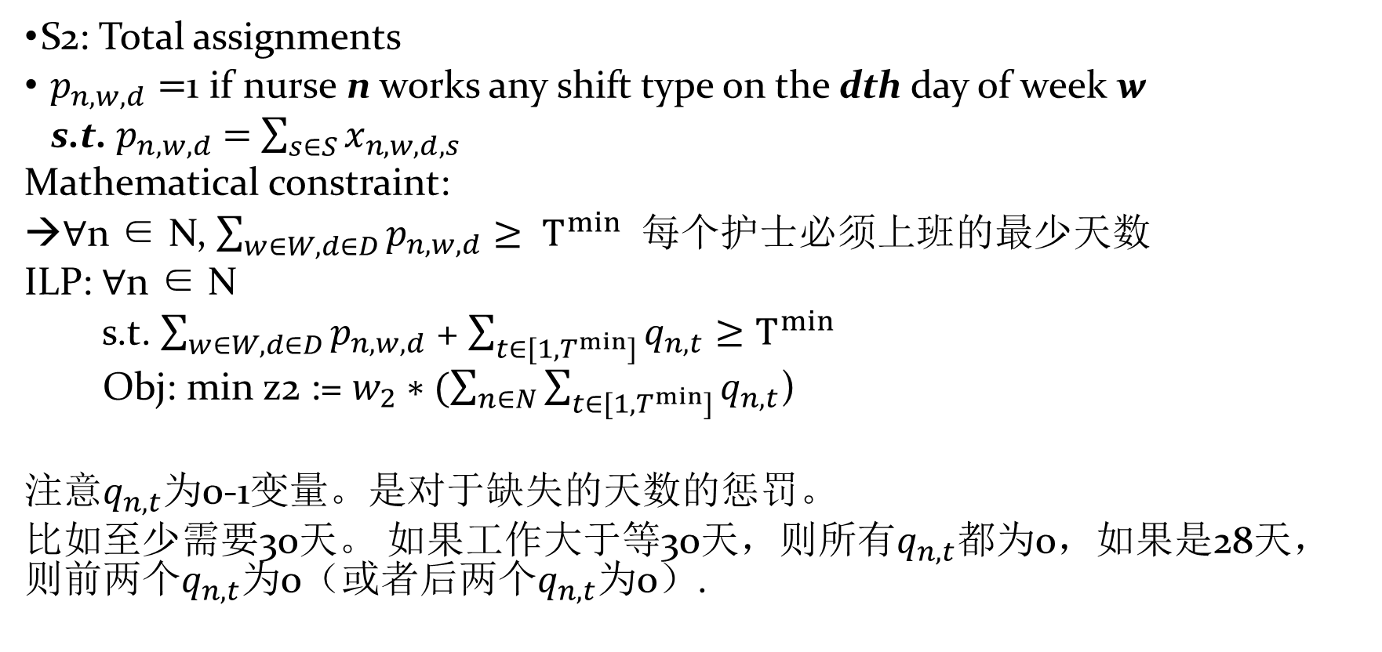
Soft (S) constraints types:
S2: Total assignments
$p_{n,w,d}=$1 if nurse n works any shift type on the dth day of week w
s.t. $p_{n,w,d}$ $=$ $\sum_{s∈S}{x_{n,w,d,s}}$
Mathematical constraint:
→∀n ∈ N, $\sum_{w∈W,d∈D}{p_{n,w,d}}≥ T^{min}$ 每个护士必须上班的最少天数
ILP: ∀n ∈ N
s.t. $\sum_{w∈W,d∈D}{p_{n,w,d}}$ + $\sum_{t∈{[1,T}^{min}]}{q_{n,t}}≥T^{min}$
Obj: min z2 := $w_{2}∗(\sum_{n∈N}{\sum_{t∈{[1,T}^{min}]}{q_{n,t}}}$)
注意$q_{n,t}$为0-1变量。是对于缺失的天数的惩罚。
比如至少需要30天。 如果工作大于等30天，则所有$q_{n,t}$都为0，如果是28天，则前两个$q_{n,t}$为0（或者后两个$q_{n,t}为$0）.

Slide 73
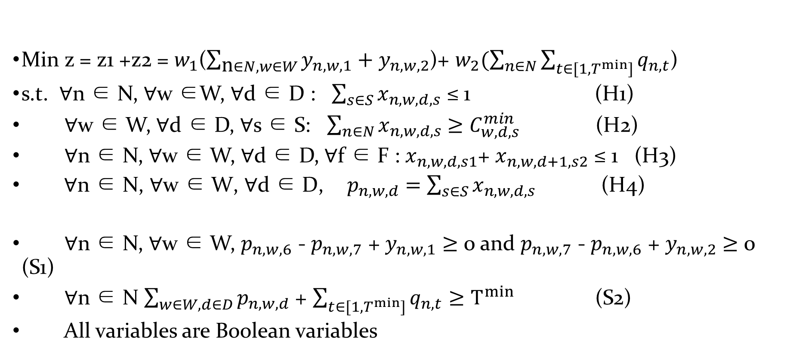
Overall (0-1 ILP):
Min z = z1 +z2 = $w_{1}$($\sum_{\text{n}∈N, w∈W}{y_{n,w,1}}+y_{n,w,2}$)+ $w_{2}(\sum_{n∈N}{\sum_{t∈{[1,T}^{min}]}{q_{n,t}}}$)
s.t. ∀n ∈ N, ∀w ∈W, ∀d ∈ D : $\sum_{s∈S}{x_{n,w,d,s}}$ ≤ 1 (H1)
∀w ∈ W, ∀d ∈ D, ∀s ∈ S: $\sum_{n∈N}{x_{n,w,d,s}}$ $≥$ $C_{w,d,s}^{min}$ (H2)
∀n ∈ N, ∀w ∈ W, ∀d ∈ D, ∀f ∈ F : $x_{n,w,d,s1}$+ $x_{n,w,d+1,s2}$ ≤ 1 (H3)
${ \text{∀}\text{n}\text{ ∈ }\text{N}\text{, ∀}\text{w}\text{ ∈ }\text{W}\text{, ∀}\text{d}\text{ ∈ }\text{D}\text{,} p}_{n,w,d}$ $=$ $\sum_{s∈S}{x_{n,w,d,s}}$ (H4)
∀n ∈ N, ∀w ∈ W, $p_{n,w,6}$ - $p_{n,w,7}$ + $y_{n,w,1}$ $≥$ 0 and $p_{n,w,7}$ - $p_{n,w,6}$ + $y_{n,w,2}$ $≥$ 0 (S1)
∀n ∈ N $\sum_{w∈W,d∈D}{p_{n,w,d}}$ + $\sum_{t∈{[1,T}^{min}]}{q_{n,t}}≥T^{min}$ (S2)
All variables are Boolean variables

Slide 74
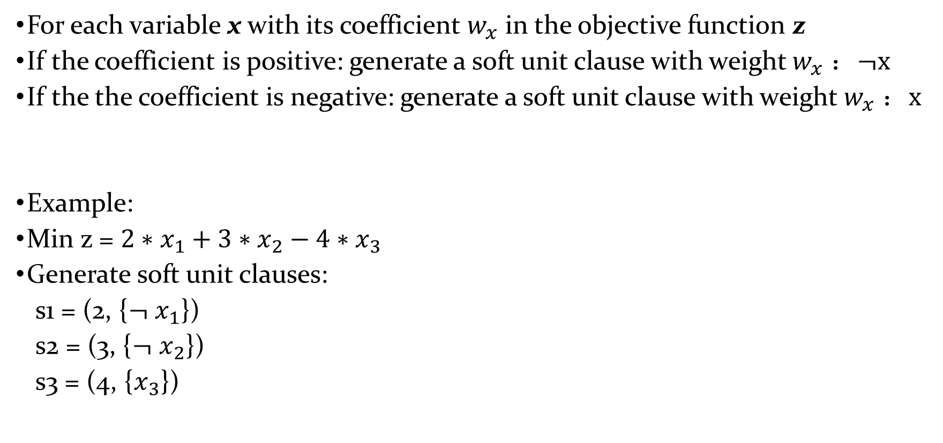
0-1 ILP into Partial MaxSAT: objective function
For each variable x with its coefficient $w_{x}$ in the objective function z
If the coefficient is positive: generate a soft unit clause with weight $w_{x}$ ：$¬x$
If the the coefficient is negative: generate a soft unit clause with weight $w_{x}$ ：$x$
Example:
Min z = ${2∗x}_{1}+{3∗x}_{2}−4∗x_{3}$
Generate soft unit clauses:
s1 = (2, {$¬$ $x_{1}$})
s2 = (3, {$¬$ $x_{2}$})
s3 = (4, {$x_{3}$})

Slide 75

0-1 ILP into Partial MaxSAT: constraints
For each constraint in ILP, we need a set of hard clauses to encode such a constraint.
The main difficult is to deal with cardinality constraints.
e.g. $\sum_{n∈N}{x_{n,w,d,s}}$ $≥$ $C_{w,d,s}^{min}$ (H2)
$≤$ and = can be expressed using $≥$.

Slide 76

Cardinality constraints
Cardinality constraints impose limits on the truth values assigned to literals.
These are atLeast_k[$x_{i}:x_{i}∈X$], atMost_k[$x_{i}:x_{i}∈X$] and exactly_k[$x_{i}:x_{i}∈X$], which constraint that at least, at most and exactly k literals out of the specified ones must or may be assigned to true.
atMost_k[$x_{i}:x_{i}∈X$] ←→ atLeast_{n-k}[$¬x_{i}:x_{i}∈X$],
exactly_k[$x_{i}:x_{i}∈X$] ←→ atLeast_{n-k}[$¬x_{i}:x_{i}∈X$] and atMost_k[$x_{i}:x_{i}∈X$]
We only consider atLeast_k[$x_{i}:x_{i}∈X$]

Slide 77

Cardinality Constraints Encoding
A simple method: Enumeration method
Forbidden all illegal assignments
Example: atLeast_2{$x_{1},x_{2}$, $x_{3}$, $x_{4}$}
Hard clauses:
h1: $x_{1}∨ x_{2}$ $∨$ $x_{3}$ $∨ x_{4}$
h1: ${¬x}_{1}∨ x_{2}$ $∨$ $x_{3}$ $∨ x_{4}$
h1: $x_{1}∨ {¬x}_{2}$ $∨$ $x_{3}$ $∨ x_{4}$
h1: $x_{1}∨ x_{2}$ $∨$ ${¬x}_{3}$ $∨ x_{4}$
h1: $x_{1}∨ x_{2}$ $∨$ $x_{3}$ $∨ {¬x}_{4}$

Slide 78

Cardinality Constraints Encoding
Enumeration method needs $\sum_{i=1}^{i=k}{C_{n}^{i}}$ clauses (n is the number of literals and k is the cardinality)
Other methods:
Sequential encoding
Cardinality networks encoding
Pigeon-hole encoding
→all these encoding methods need at least O(nlogn) auxiliary clauses and variables

Slide 79


Cardinality Constraints and CNF
Cardinality constraints:
$l_{1}+l_{2}$+ … + $l_{n}≥k$, k$∈𝕫$, $l_{i}∈\{x_{i},{¬x}_{i}$}, $x_{i}∈\{0,1\}$
CNF clause:
{$l_{1},∨l_{2}$ $∨$ … $∨$ $l_{n}\}⇔$ $l_{1}+l_{2}$+ … + $l_{n}≥1$
Many works on efficient encodings from cardinality constraints into CNF
Into CNF
Atleast O(nlogn) additional variables and clauses
One cardinality constraint $\sum_{i=1}^{i=n}{l_{i}}≥$k

Slide 80

Cardinality Constraints via Extended CNF
Cardinality constraints:
$l_{1}+l_{2}$+ … + $l_{n}≥k$, k$∈𝕫$, $l_{i}∈\{x_{i},{¬x}_{i}$}, $x_{i}∈\{0,1\}$
CNF clause:
{$l_{1}∨l_{2}$ $∨$ … $∨$ $l_{n}\}⇔$ $l_{1}+l_{2}$+ … + $l_{n}≥1$
Our method: let’s extend the language.
( {$l_{1}∨l_{2}$ $∨$ … $∨$ $l_{n}$}, k ) ←→ $\sum_{i=1}^{i=n}{l_{i}}≥$k
Techniques under CNF can be adapted to ECNF.

Slide 81




Further Extension: Pseudo Boolean Solving/Optimization
Pseudo Boolean constraints:
${a_{1}l}_{1}+{a_{2}l}_{2}$+ … + ${a_{n}l}_{n}≥k$, $a_{i}$, k$∈𝕫$, $l_{i}∈\{x_{i},{¬x}_{i}$}, $x_{i}∈\{0,1\}$
O(nlogn) additional variables and clauses of CNF
One PB constraint: $\sum_{i=1}^{i=n}{a_{i}}l_{i}≥$k
O($\sum_{i=1}^{i=n}{a_{i}}$) additional variables and clauses of ECNF
PB has the form:
( {$a_{1}l_{1},{a_{2}l}_{2}$, … , ${a_{n}l}_{n}$}, k ) ←→ $\sum_{i=1}^{i=n}{a_{i}}l_{i}≥k$

